Slide 1


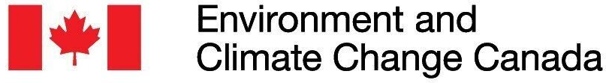


Optimally managing threats to biodiversity across large scales
Jeffrey O. Hanson, Dobrochna M. Delsen, Allison Binley, James Allan, Martin Jung, Piero Visconti, Virgilio Hermoso, Richard Schuster, Melissa Chapman, Joseph R. Bennett
jeffrey.hanson@uqconnect.edu.au
jeffrey-hanson.com

Slide 2

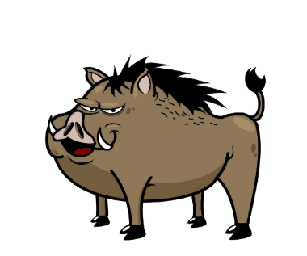






Conservation is actions in places
1. Area impacted by threat
2. Implement action to abate threat
3. Positive conservation outcome

Slide 3


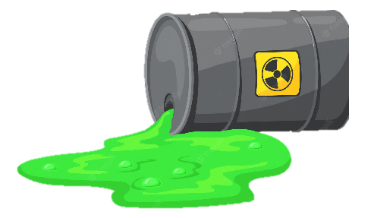
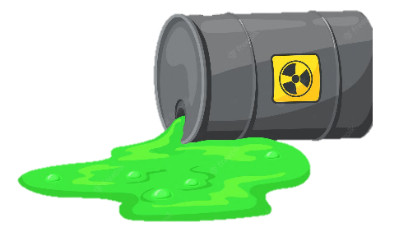
Which threats to abate?

Slide 4




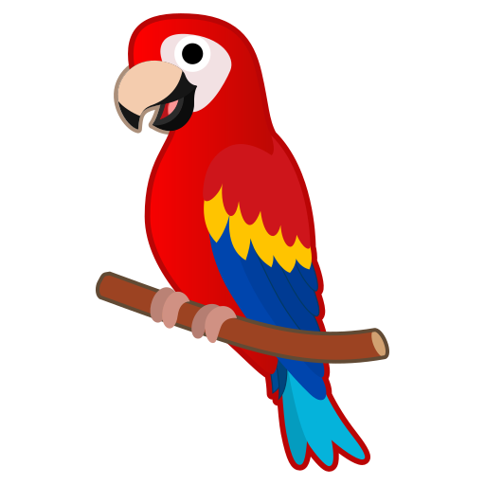
Which threats to abate?

Slide 5
Which threats to abate?
$1M
$4M
$2M
$5M

Slide 6

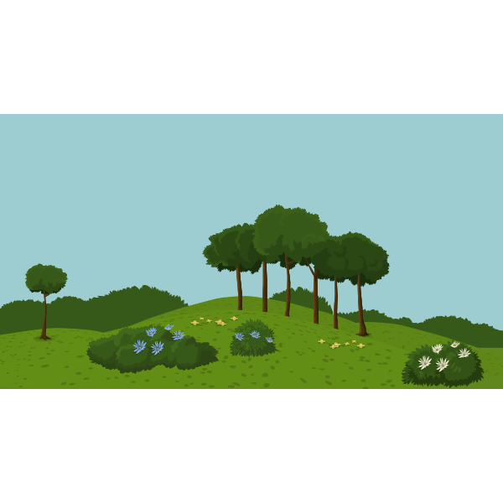
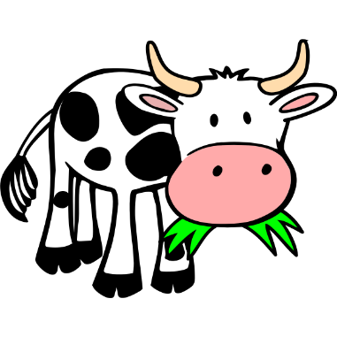
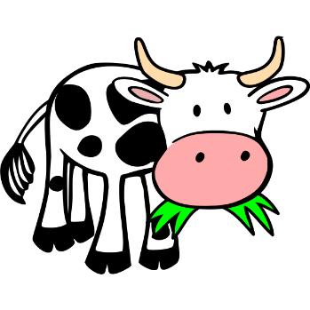



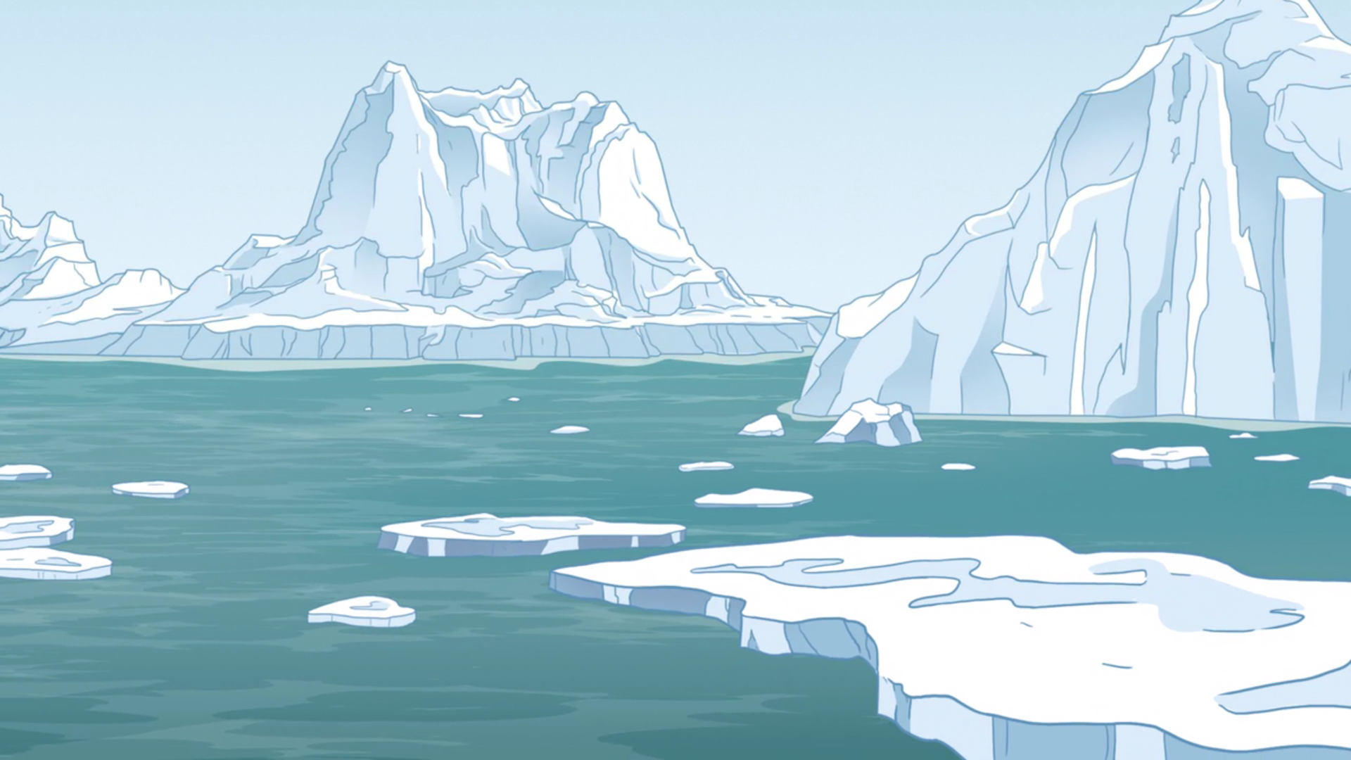


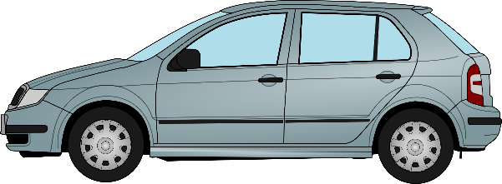

Which places to abate which threats?

Slide 7


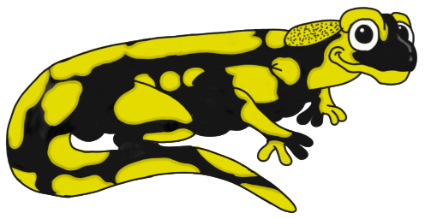
Find the cheapest set of actions needed to provide each species with adequate habitat
(assuming each place provides enough habitat for each species to persist)

Slide 8
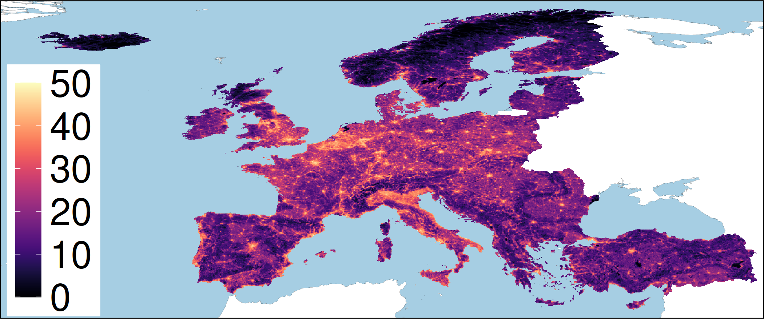
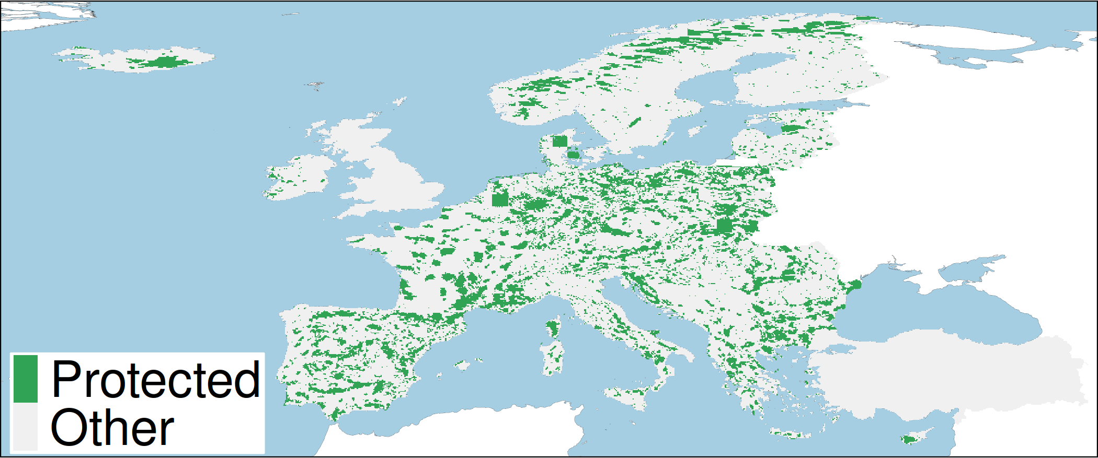
European case study
415 species: 81 amphibian, 135 birds, 79 mammal, 120 reptile species
165,000+ planning units (grid cells)
Natura 2000 network and nationally designed protected areas
Conservation benefit for a species = amount of threat-free habitat in conservation areas
Human pressure

Slide 9
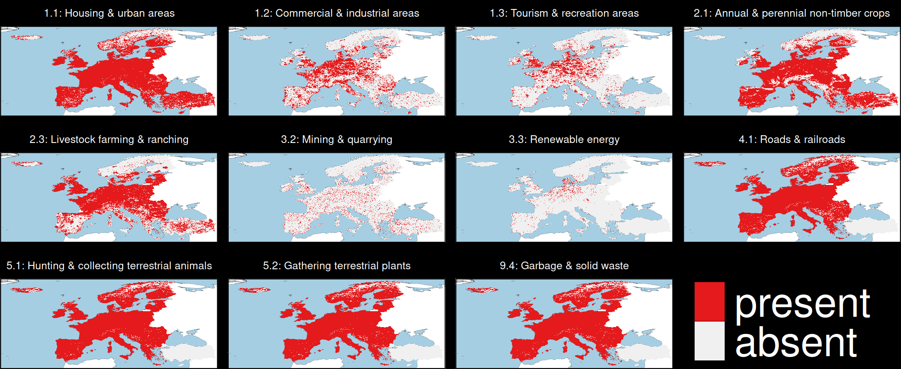
Threats to biodiversity

Slide 10

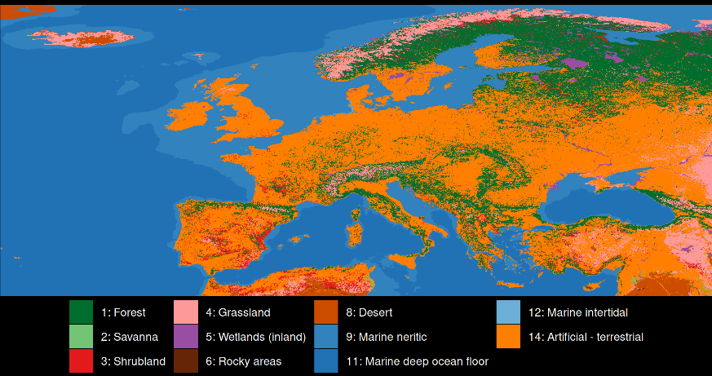
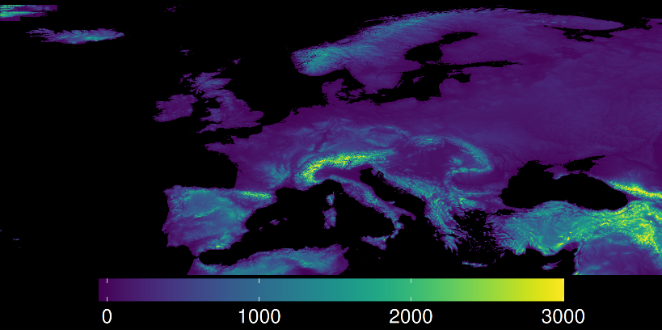
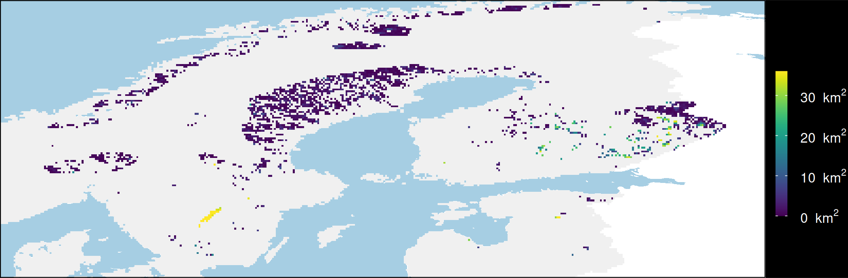
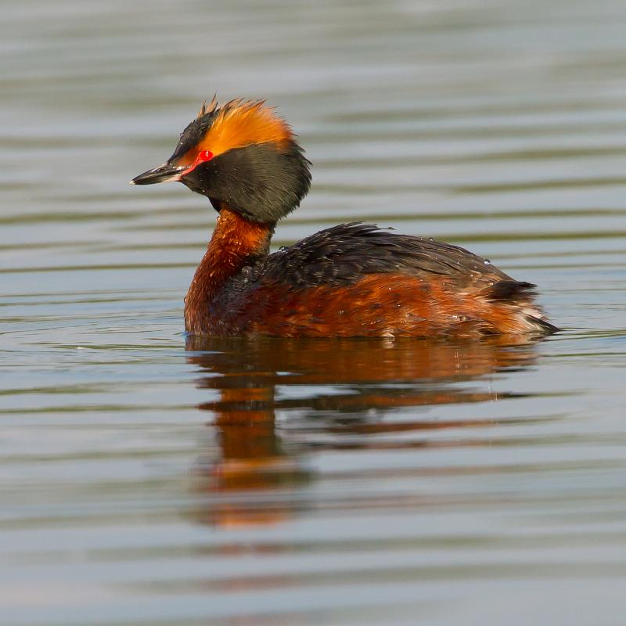
Mapping suitable habitat for species
Current land cover
Elevation
Threats
Species
habitat types
elevational limits
threat impacts
Horned Grebe
Area of threat-free habitat

Slide 11
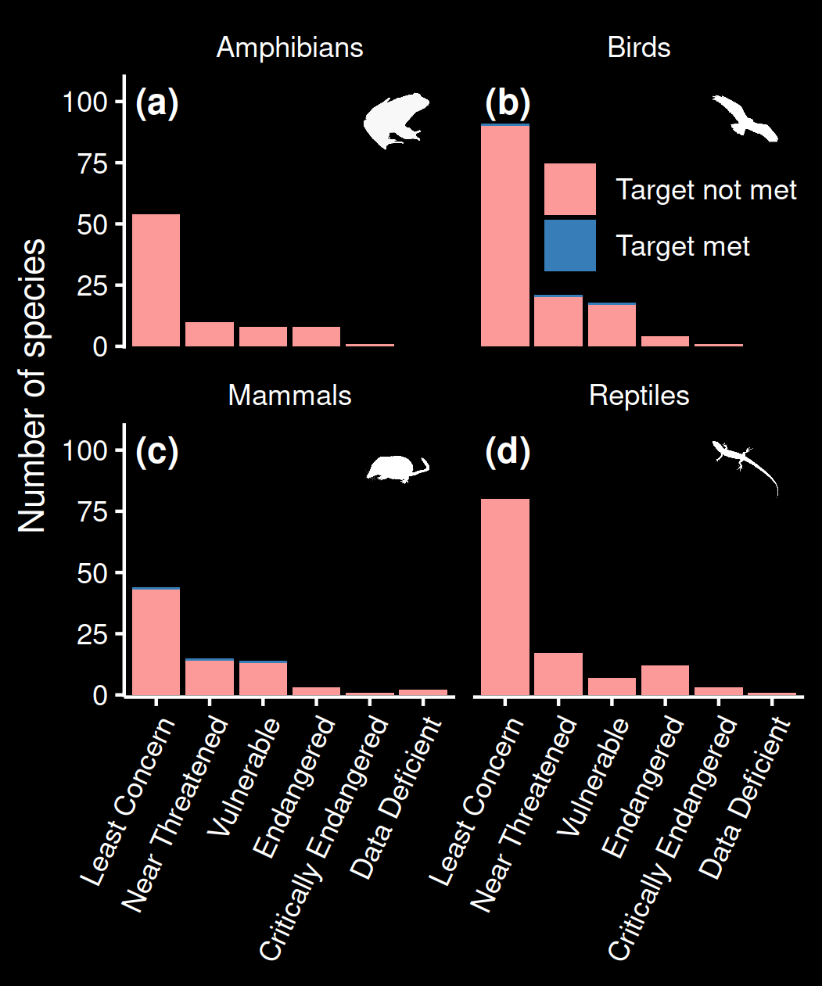
Performance of existing protected areas
Only 6 / 415 species with adequate threat-free habitat within protected areas
0 amphibians and reptiles!
Much worse than previous assessments which don’t account for threats

Slide 12

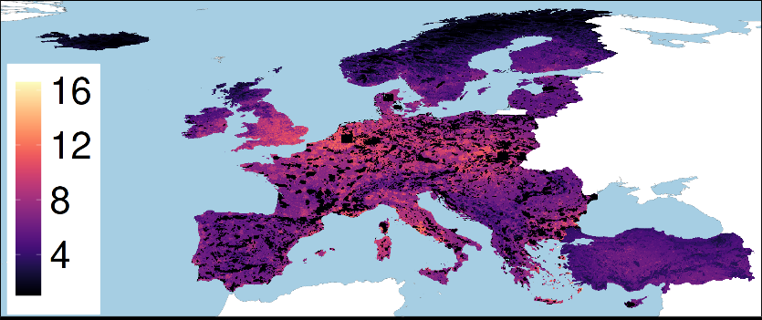
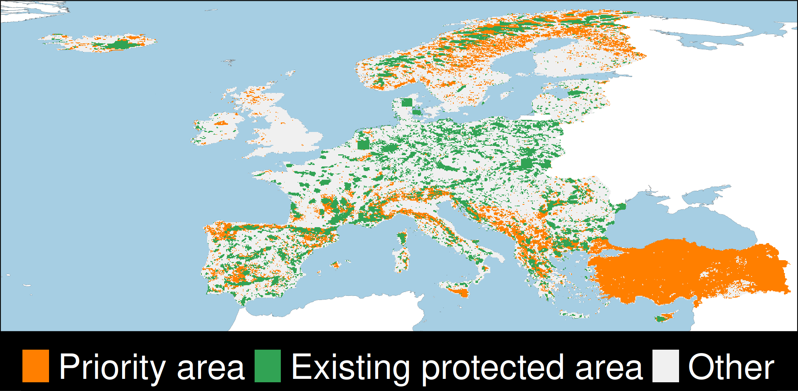

Priority areas for establishing protected areas
Existing threat-free
habitat for 415 species
Protected areas
Opportunity cost
Optimization
prioritizr

Slide 13
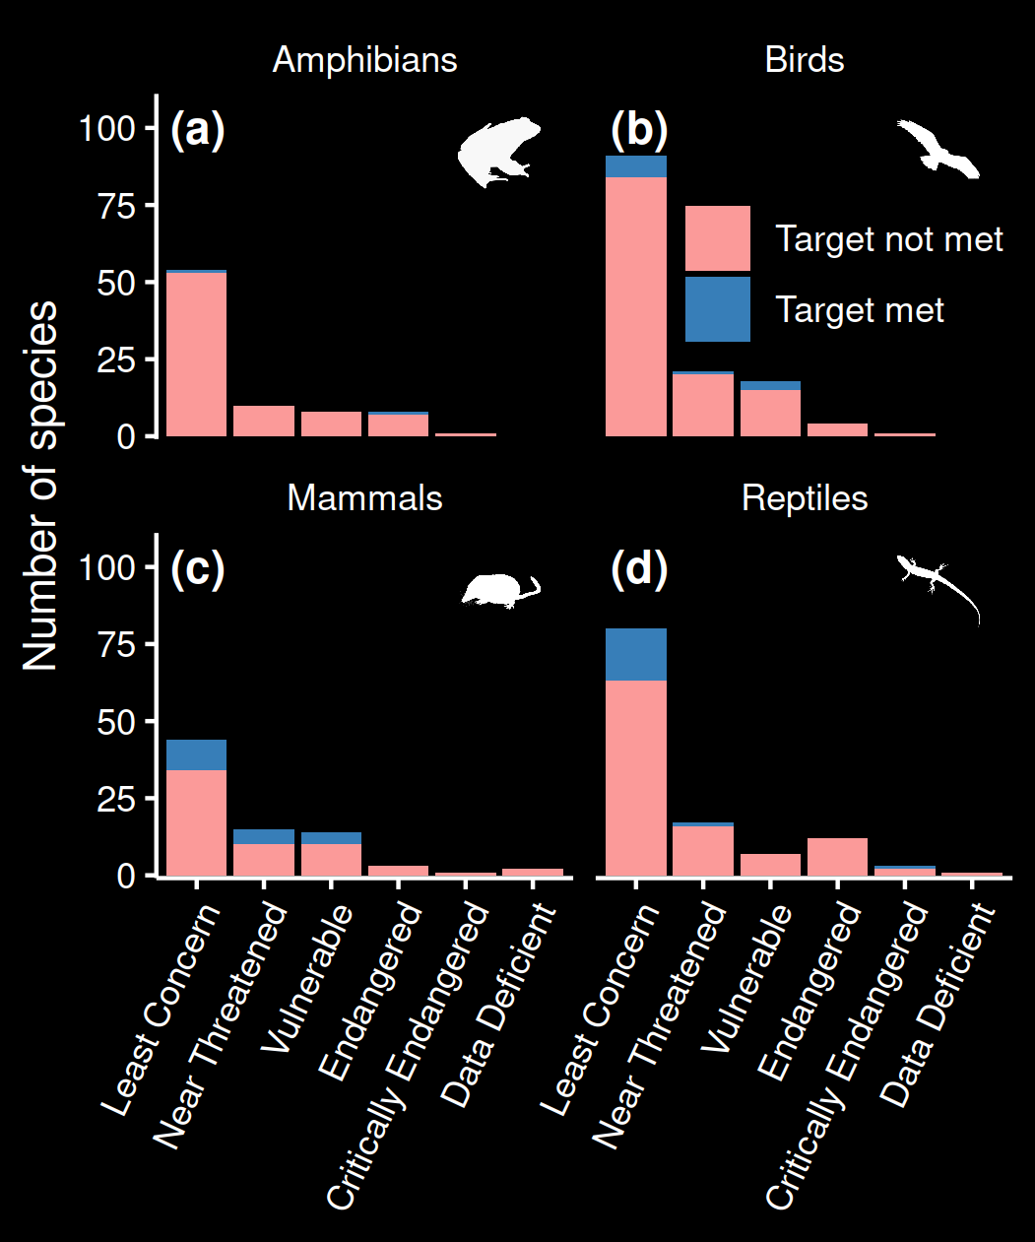
Establishing new protected areas
Improves to 51 / 415 species with adequate threat-free habitat within protected areas
Most species are Least Concern
Still only 2 amphibians

Slide 14
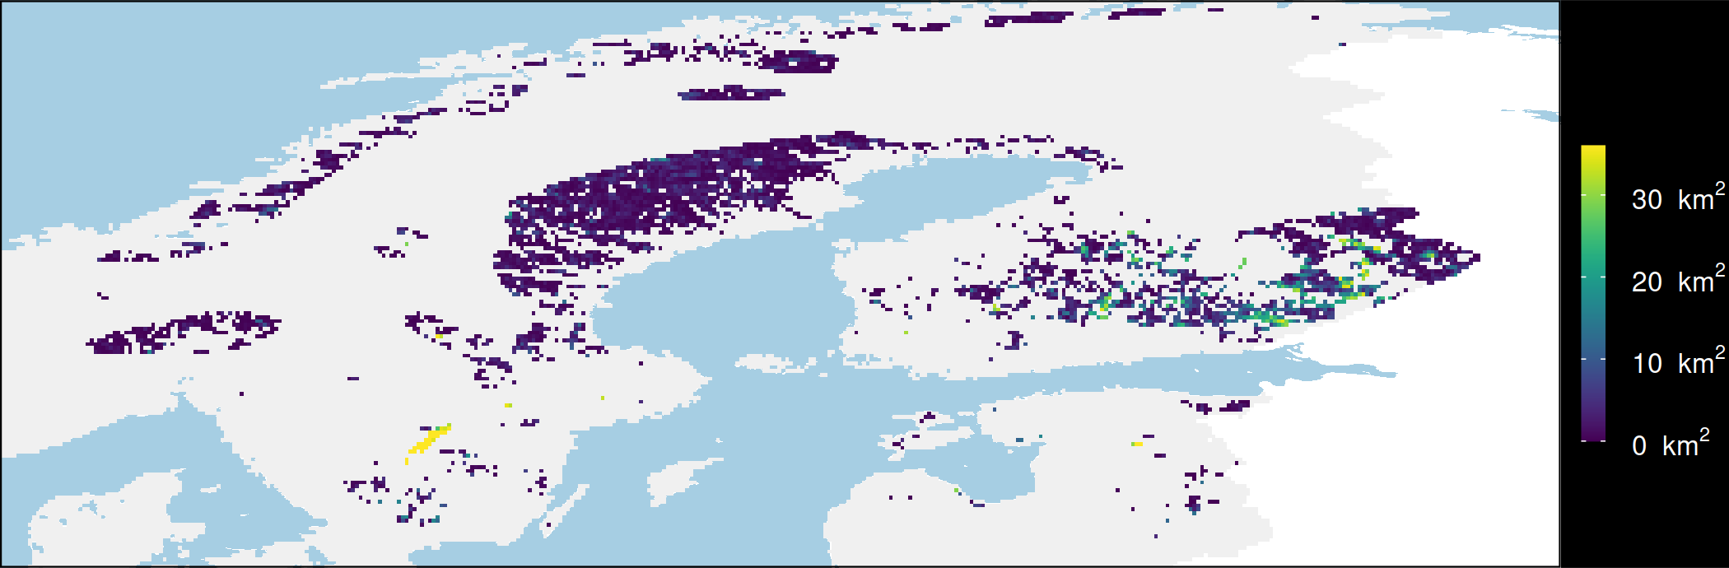


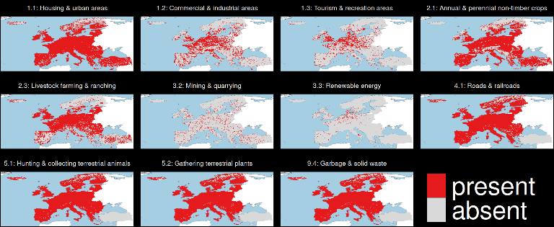
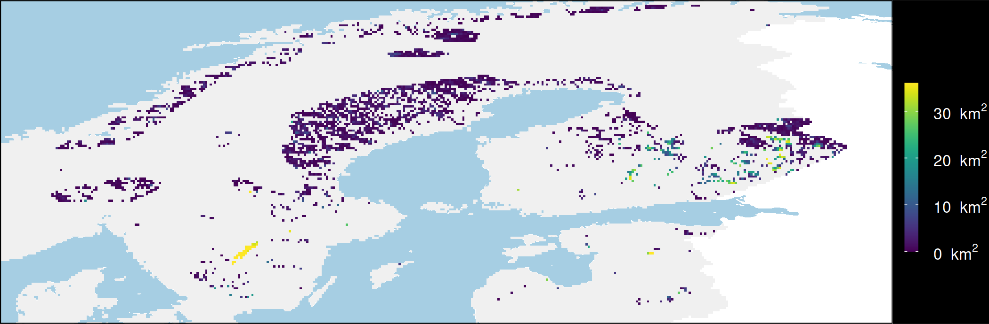
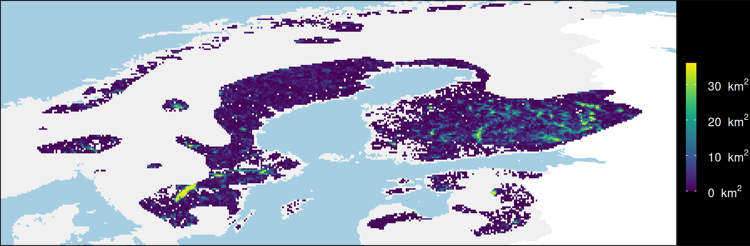

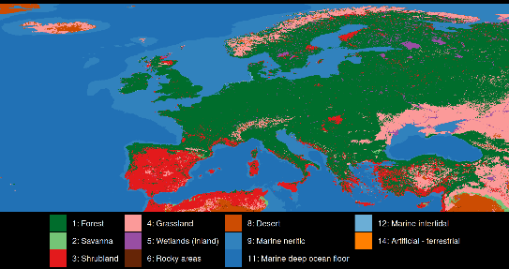
Mapping consequences of abating threats
Protect existing habitat
Species
Elevation
Horned Grebe
Restore urban areas
Threats
What if?
Restore croplands
Current
land cover
Potential natural
vegetation
Restore urban & croplands

Slide 15
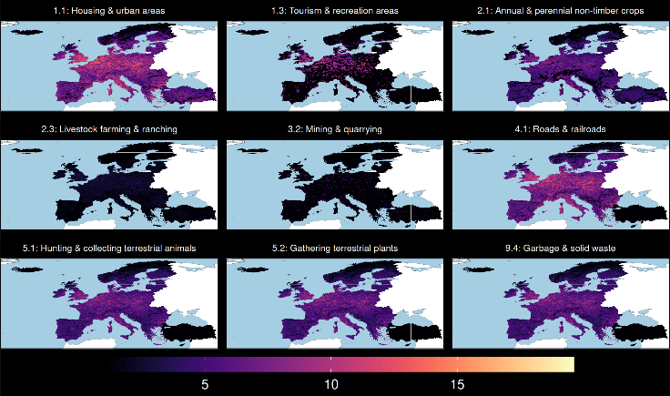
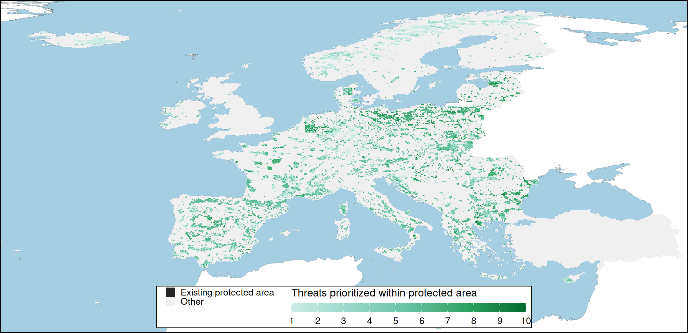
Prioritizing improvement of protected areas
Consequence maps for 415 species under 512 threat combinations
Opportunity costs for each threat
Protected areas
Optimization
prioritizr

Slide 16
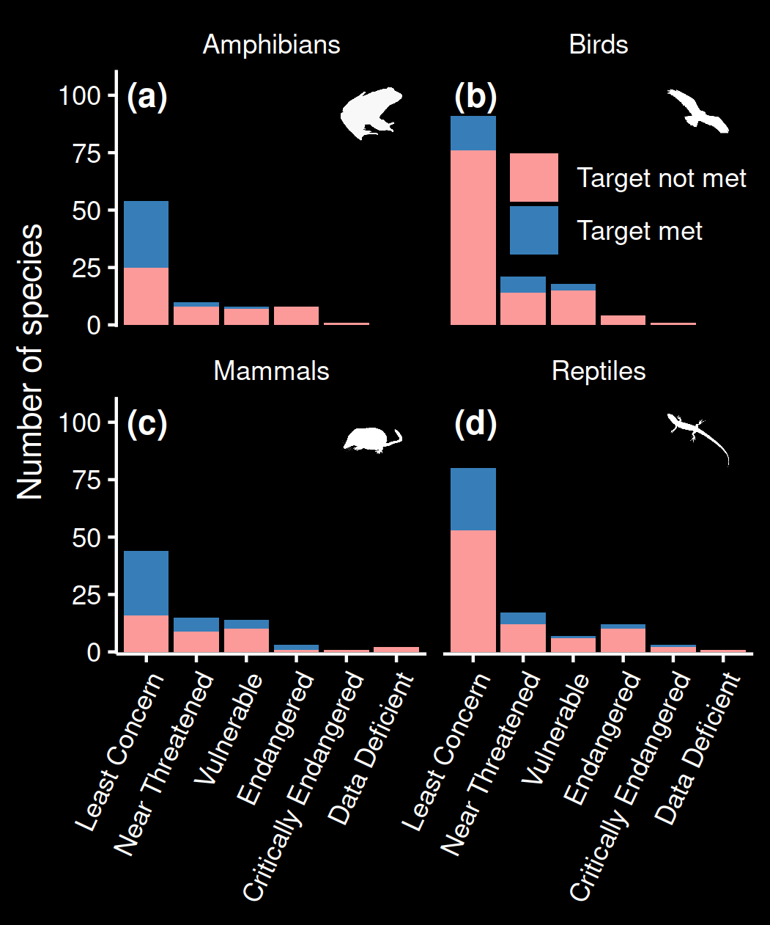
Improving existing protected areas
Bigger improvement to 133 / 415 species with adequate threat-free habitat within protected areas
39% amphibian, 19% bird 50% of mammal, and 30% of reptile species

Slide 17
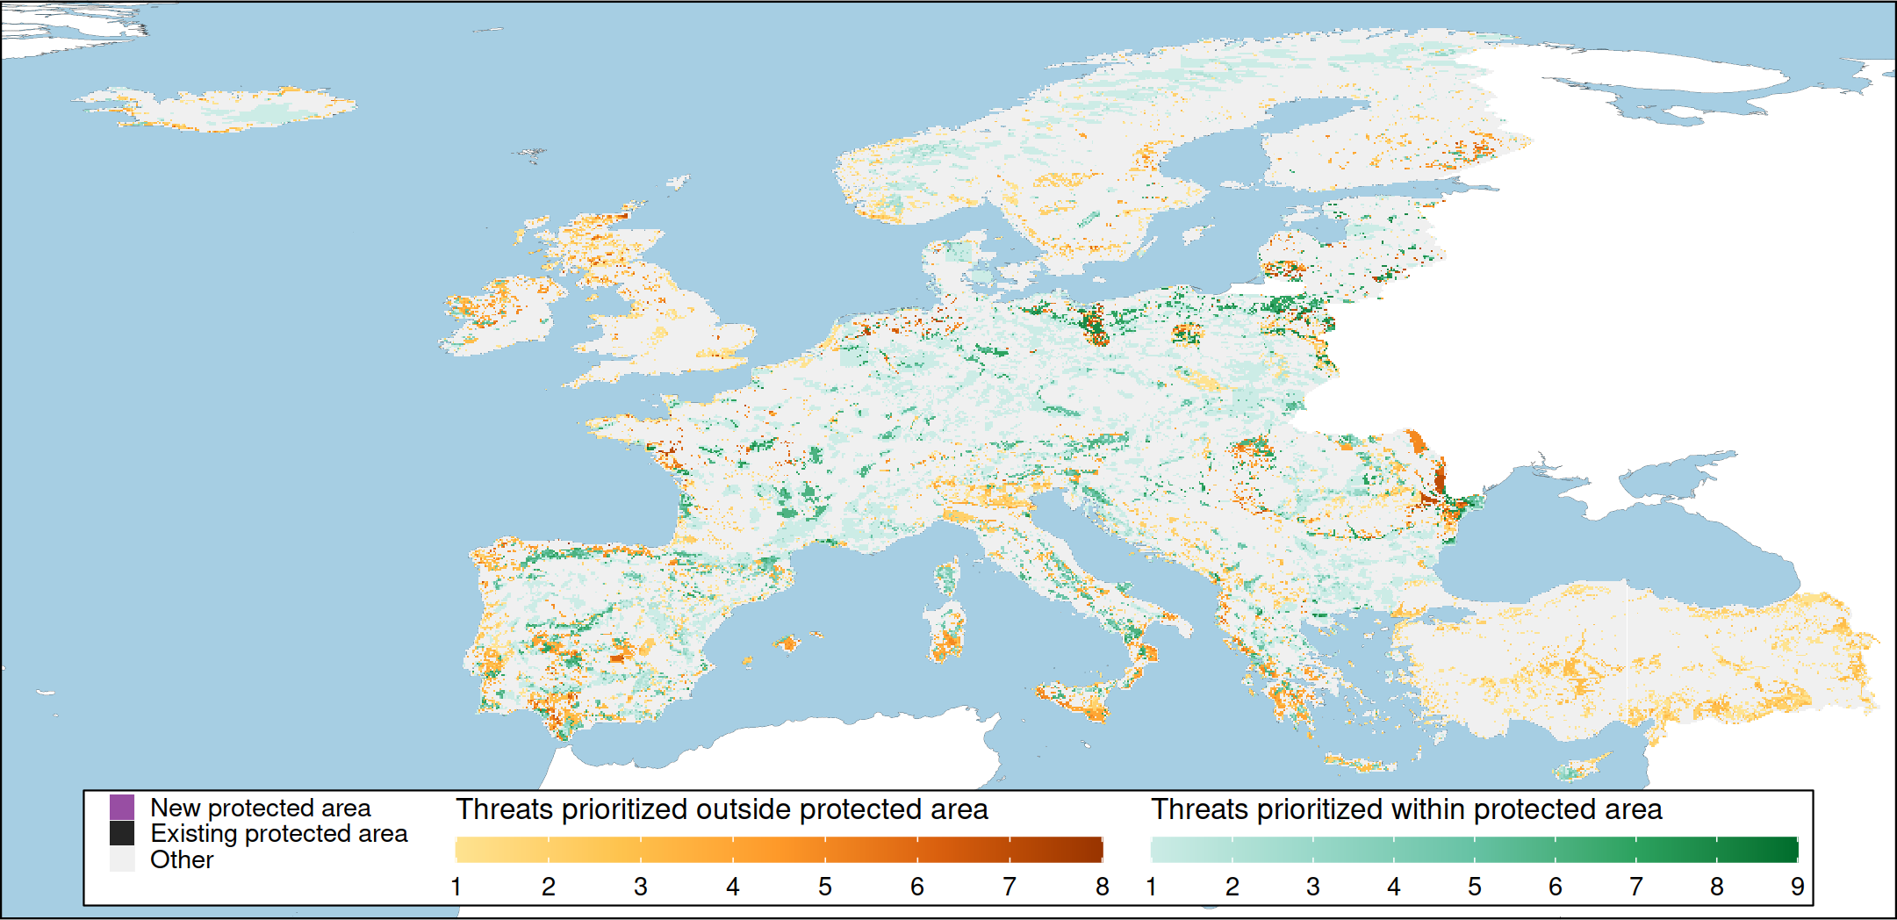
Prioritizing actions across Europe

Slide 18
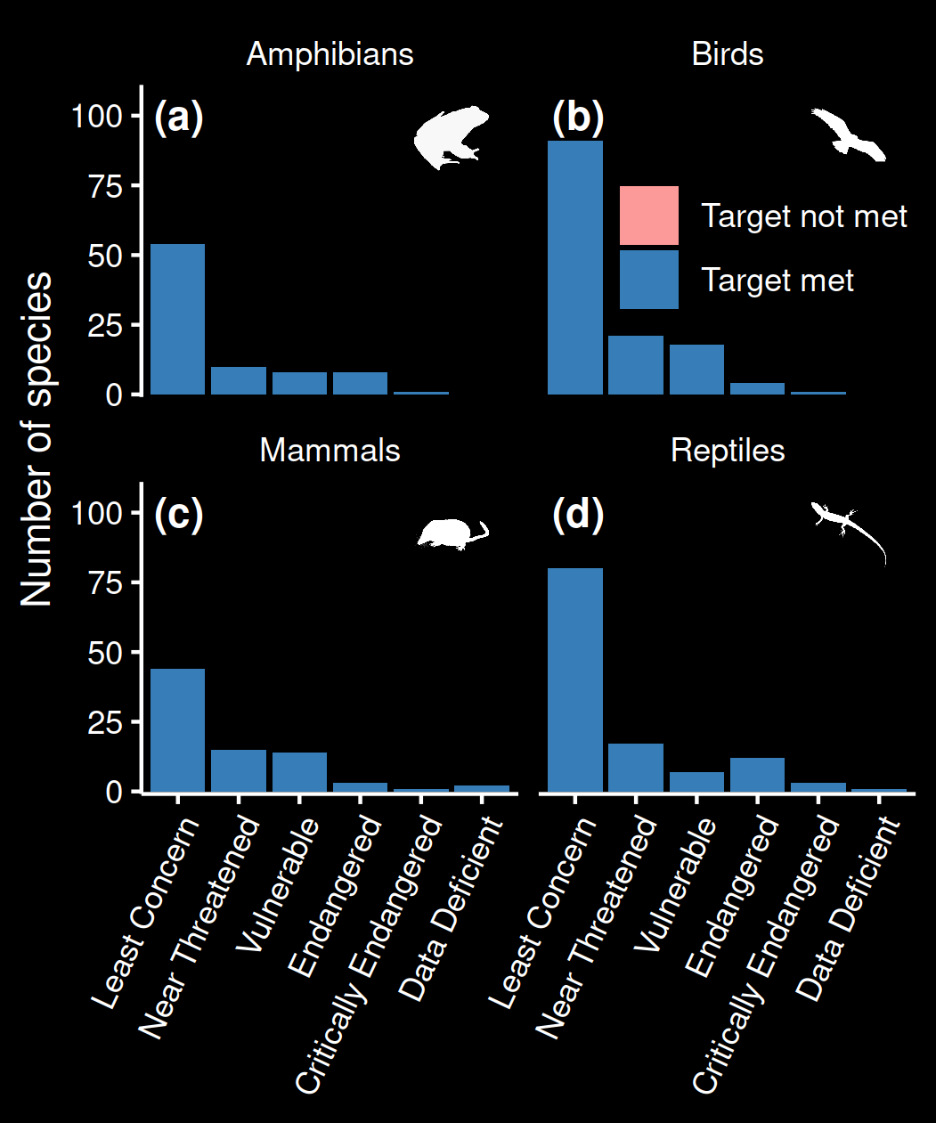
Prioritizing actions to abate threats
All species have adequate threat-free habitat within protected areas
Priority areas for abating threats span 17% of Europe

Slide 19
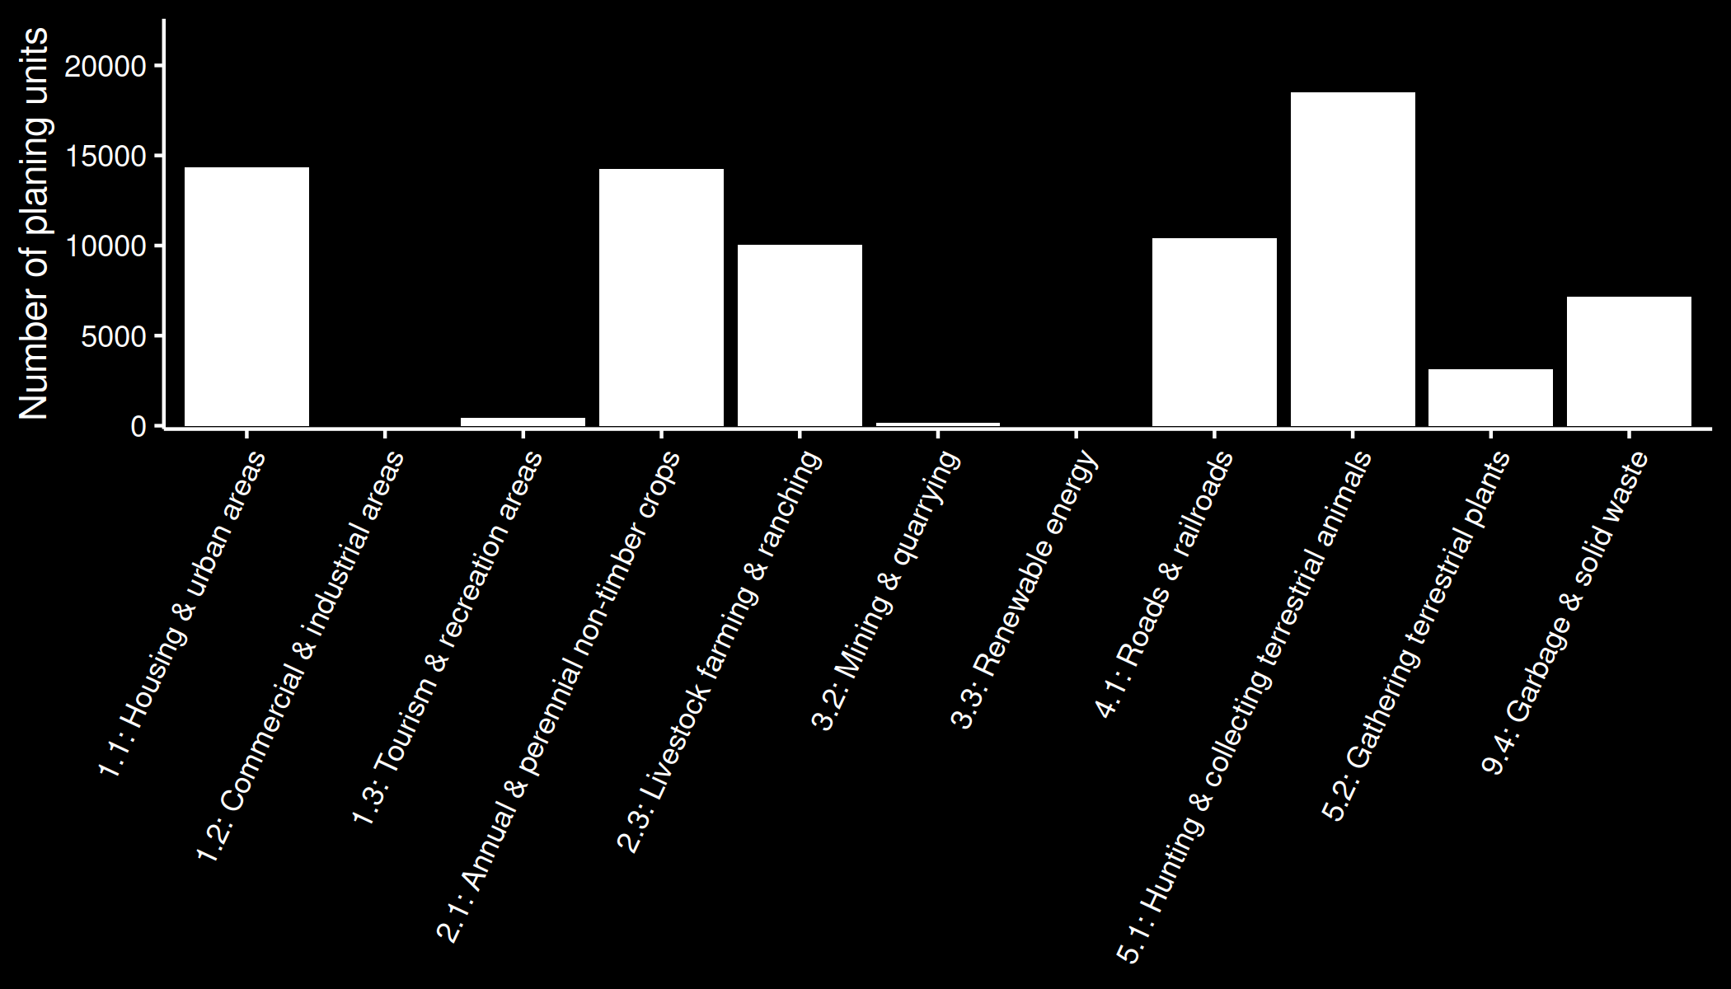
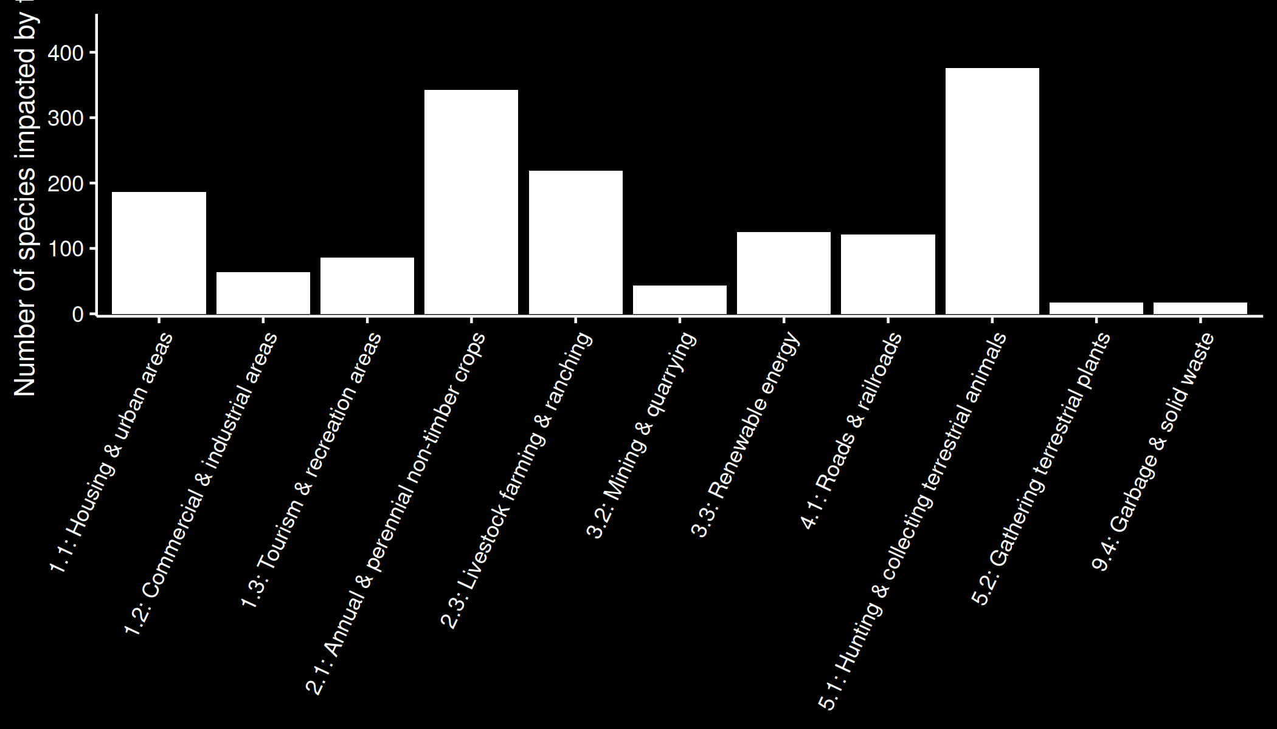
Number of planning units in prioritization
Number of
species impacted

Slide 20
Focussing on threats that impact the most species isn’t a bad start
Number of planning units in prioritization
Number of
species impacted

Slide 21
Number of planning units in prioritization
Number of
species impacted
But that’s not the whole story, other threats may be important too

Slide 22
Take home messages
Most EU species don’t have adequate habitat in protected areas that is free from threats
Improving management of existing protected areas is insufficient for many species
Strategically managing threats both within and beyond existing protected areas is needed
What you do and where you go matters!

Slide 23




jeffrey.hanson@uqconnect.edu.au
github.com/jeffreyhanson
jeffrey-hanson.com

